Slide 1
ABC Football Challenge
The ABC football challenge is open to students in years 7-11 girls and boys
Students will take part in 3 challenges – football agility, balance and co-ordination
The 3 scores for each challenge will be added together to form a final score.
There are two levels of challenge – Level 1 and Level 2
Students can decide which level they want to try.

Slide 2
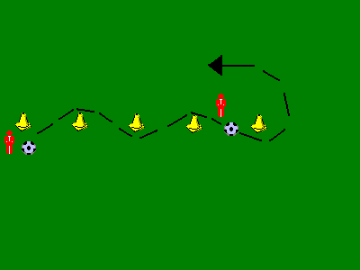
ABC Football Challenge
Level 1
Agility -https://youtu.be/ZtiDGmyoCLk
Set up 5 cones within a 3 metre area
You will have one minute to score as many points as possible. When the timer starts, you must dribble a ball around the cones, 1 – 5 and back again. You will score one point for every cone you go around.
Going around all 5 cones there and back would be 8 point.
Balance - https://youtu.be/sywfo2BiHM8
Time how long you can balance a football on your foot.
Co-ordination - https://youtu.be/kNjfi2TE4lA
How many consecutive keepy-uppies can you do in one minute. Record your score

Slide 3
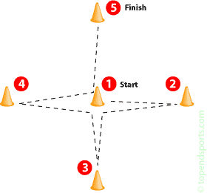
ABC Football Challenge
Level 2
Agility - https://youtu.be/DF1ywXRk0zw
Set up 5 cones like the diagram above, each cone must be 2 metres apart from the middle cone.
You will have one minute to score as many points as possible. When the timer starts, you must dribble a ball from the middle cone (cone 1) to the one on the left (cone 2) go around it then dribble back to the middle cone. This is then repeated with cones 3, 4 and 5 . You continue in this sequence for 1 minute
You score 1 point for every cone you go around. A full sequence of cone 1 to cone 2 to cone 1 to cone 3 to cone 1 to cone 4 to cone 1 to cone 5 to cone 1 would be 8 points)
Balance - https://youtu.be/egZHkBpisD8
Time how long you can balance a football on your foot.
Co-ordination - https://youtu.be/9qKTfftWjuo
Set up 2 cones two metres apart.
See how many times you can travel from one cone to the other in one minute while you do football keepy uppies on the move.
You score I point for each time you go from one cone to the other. If the ball touches the floor you will need to go back to the start of the cone.

Slide 4
ABC Football Challenge
RESULTS
Level 1
Agility | Balance no. of seconds | Co-ordination | TOTAL
Level 2
Agility | Balance no. of seconds | Co-ordination | TOTAL

